Slide 1
K- Nearest Neighbor
By Ali Saeed

Slide 2
Introduction
The k-nearest neighbors (KNN) algorithm is a simple, supervised machine learning algorithm that can be used to solve both classification and regression problems.
It's easy to implement and understand, but has a major drawback of becoming significantly slows as the size of that data in use grows
User set the value of K that must be positive

Slide 3
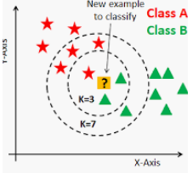
Introduction
Following figure explaining the detailed working of KNN

Slide 4
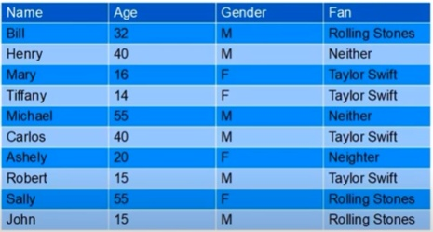
Data Set

Slide 5

Formula
First convert the “labeled data” into numeric data using One-Hot encoding (because we need to perform calculations)
Like Male=0 and Female=1
Following is a formula to compute distance:

Slide 6
Unseen Instance
Age of “Michelle” is 5 and she is a female. Predict its class?
Predict the class of above mentioned instance?

Slide 7
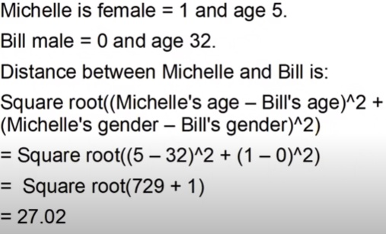
Compute Distance
First person in the dataset is “Bill”

Slide 8
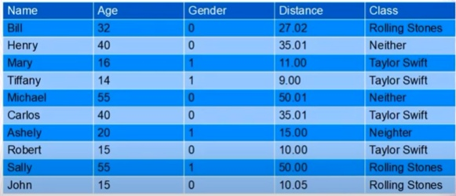
Compute Distance
Compute the distance between Michelle and everyone in the dataset like as follows:

Slide 9
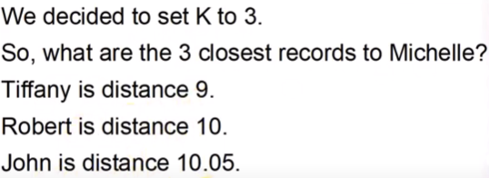
Find closest data items
So the final class of Michelle is Talyor Swift

Slide 10
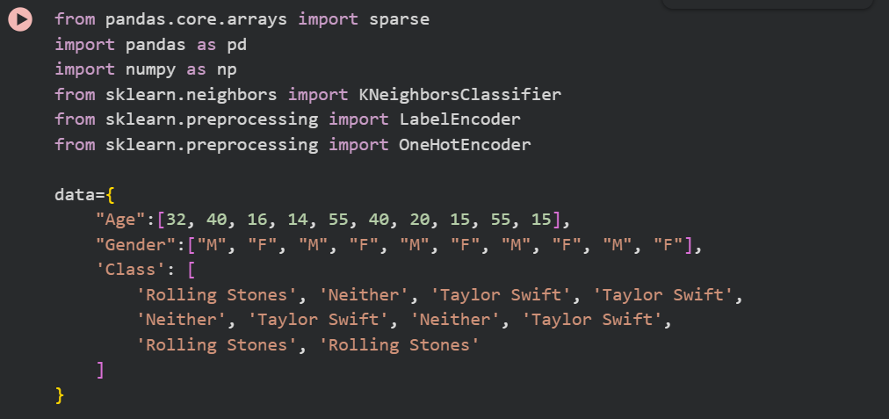
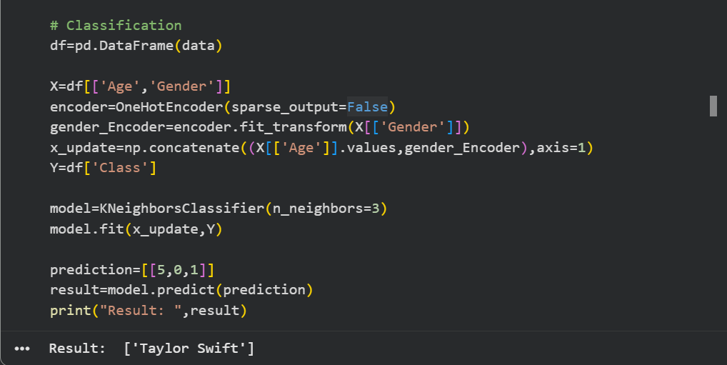

Slide 11
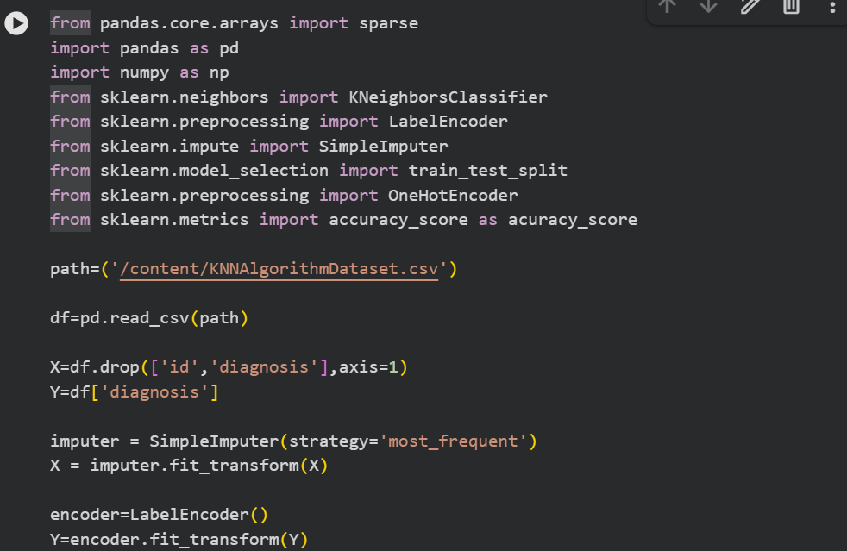
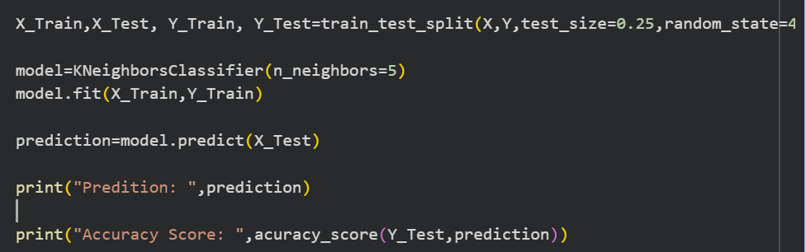

Slide 12
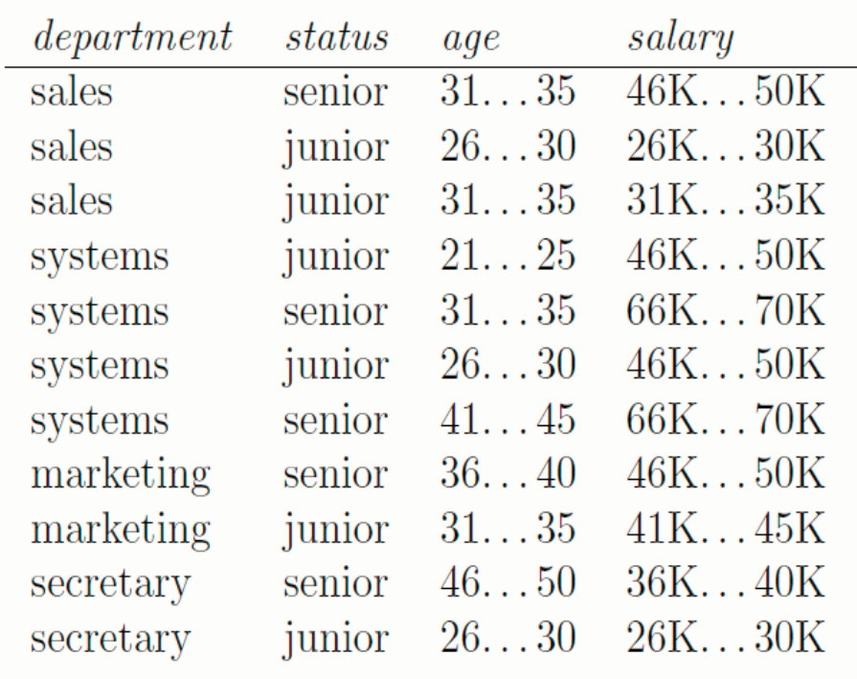
Data Set

Slide 13
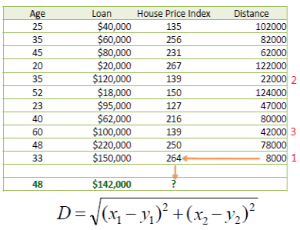
KNN used for Regression

Slide 14
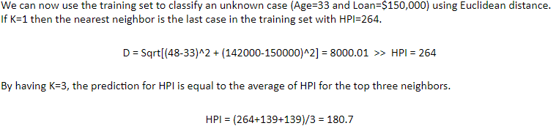
Regression

Slide 15
How can we use KNN to solve NLP tasks
Apply manual feature engineering
Convert the text into tables
Convert all “symbolic” data into “numeric” data using One-hot encoding.
Develop classifier or regresses, depend on the task.

Slide 16
Language Text
Sentences | Actual
He likes sweets. | +ve
I am not flying to England. | -ve
She did not like Bikhram yoga. | -ve
He will come tomorrow. | +ve
They don't practice yoga. | -ve
Do positive. | +ve
He doesn't have to commute to work. | -ve
Pakistan is one of the best countries in the world. | +ve

Slide 17
POS Tags based approach
At1 | At2 | At3 | At4 | At5 | Class
PR | VB | NNS | - | - | +ve
PRP | VB | RB | TO | NNP | -ve
PRP | VB | VBB | NNP | NN | -ve
PRP | MD | VB | NN | - | +ve
PRP | VB | R | VB | NN | -ve
V | JJ | - | - | - | +ve
PRP | VBZ | RB | V | TO | -ve
NNP | VB | C | IN | DT | +ve
PRP | VBP | RB | VB | NNP | ?

Slide 18
Thanks

